Slide 1

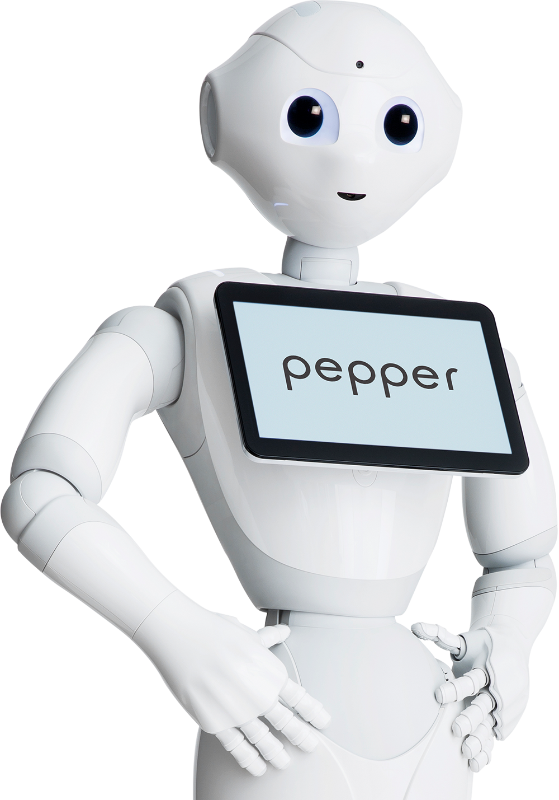


DIEM INVADERS
C.FUCILE - E.GUZZO - E. MAFFUCCI - M.PREZIOSI - S.SALDUTTI - S.SCALA - R.SQUITIERI - A.TOZZA – B.VENTO
A.A. 2019/20 – SOFTWARE ENGINEERING

Slide 2
ROLES
PRODUCT OWNER:
STEFANO SALDUTTI
SCRUM MASTER:
BRUNO VENTO
DEVELOPMENT TEAM:
CARMEN FUCILE
ELENA GUZZO
EDOARDO MAFFUCCI
MARCO PREZIOSI
SALVATORE SCALA
RAFFAELE SQUITIERI
ANTONIO TOZZA

Slide 3
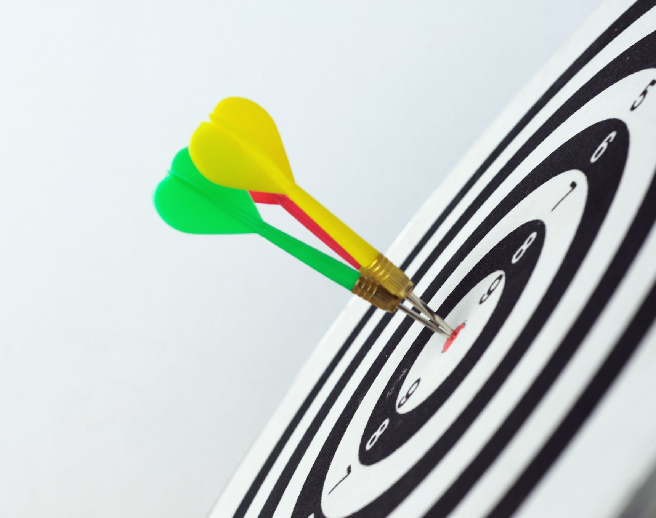
TARGET
IN THE FIRST SPRINT, OUR GOAL IS TO MAKE A WORKING FIRST DEMO OF GAME, WITH PEPPER ABLE TO MOVE ON A CERTAIN POSITION ONLY LEFT AND RIGHT, ABLE TO DODGE BOOKS THAT FALL DOWN RANDOMLY. THE GAME IS EQUIPPED WITH A HUD BAR THAT UPDATES WHENEVER PEPPER HITS A BOOK.

Slide 4
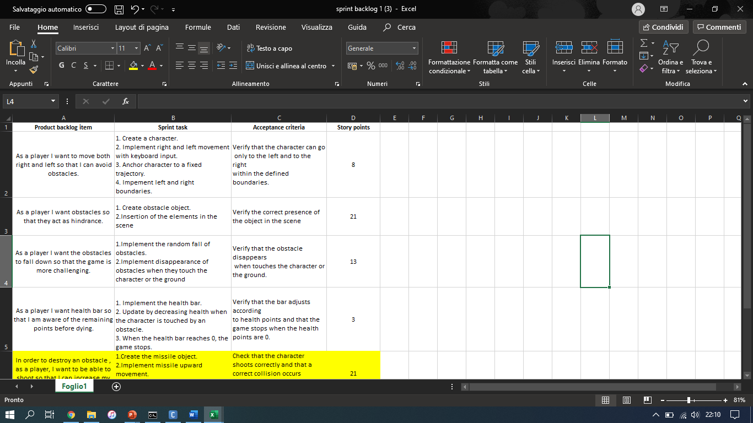
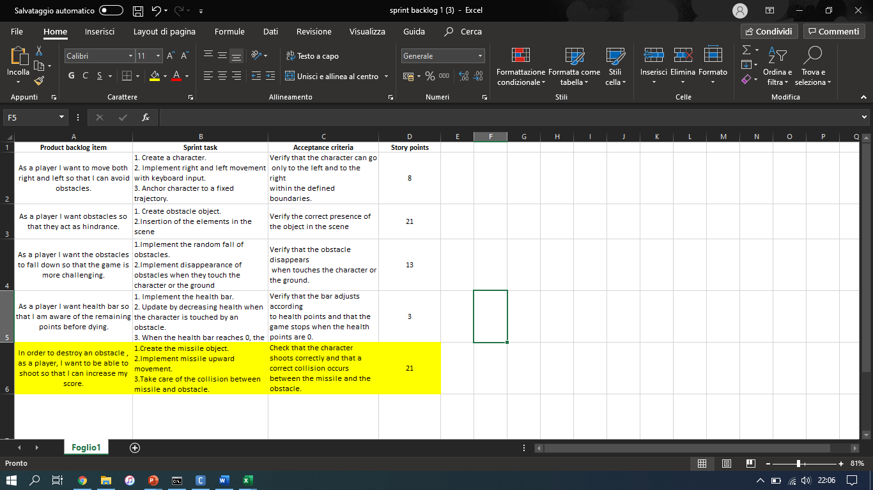
FIRST SPRINT
FIRST SPRINT ESTIMATED VELOCITY: 45
FIRST SPRINT
REAL
UPDATED
VELOCITY: 66
+

Slide 5

TASKS PERFORMED
CREATE PEPPER AND MANAGE DIMENSIONS;
ANCHOR PEPPER AND MANAGE THE BOUNDARIES;
MANAGE THE RANDOM CREATION AND DESCENT OF BOOKS;
MANAGE THE INTERSECTION OF PEPPER WITH THE OBSTACLES;
MANAGING THE CREATION AND UPDATING OF THE HEALTH BAR;

Slide 6
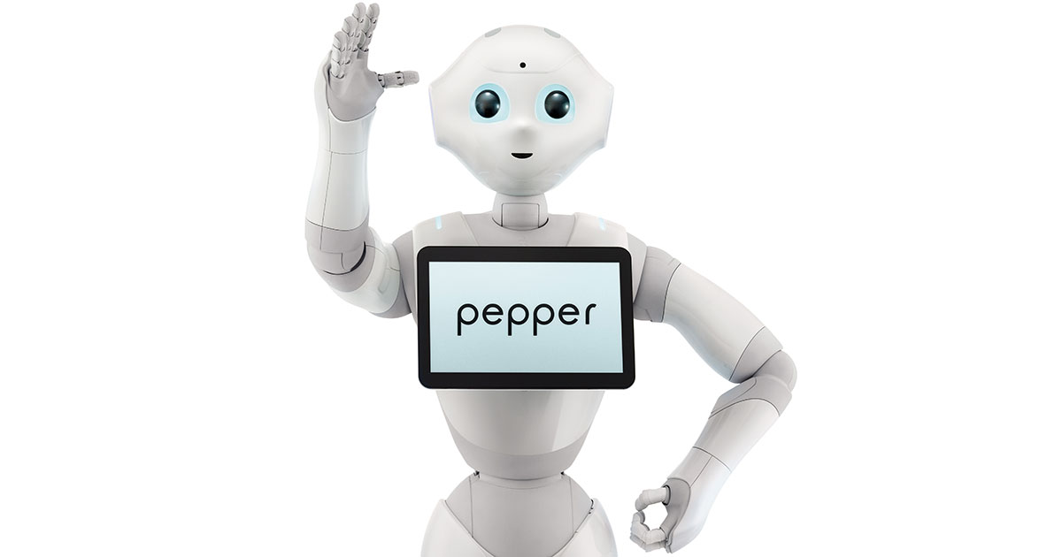
SPECIAL TASKS PERFORMED
MANAGE THE CREATION OF SHOTS FIRED BY PEPPER;
MANAGE THE INTERSECTION OF SHOTS FIRED BY PEPPER AND FALLING OBSTACLES;

Slide 7
RISK ANALYSIS – SWING VS FX
JAVA SWING
JAVA FX
Extends the JFrame class and to display user-interface components, you add components to a JPanel and then add the panel to the frame;
Animation is possible in Swing, but Swing does not provide any direct support for it;
Greater knowledge of the framework;
A stage represents the highest level container. The individual controls and other components that make up the user interface are contained in a scene;
An application can have more than one scene, but only one of the scenes can be displayed on the stage at any given time. Scene contains a scene graph, which is the most important concept in JavaFX. The scene graph is a collection of all the elements that make up a user interface;
One of the best features of JavaFX is that you can control formatting with CSS;
JavaFX has several interesting controls that Swing doesn’t have;
Poor knowledge of the framework;

Slide 8

SPRINT REVIEW
ALL TASKS MEET THE DEFINITION OF DONE, AS FOR EVERY TASK THE AUTOMATIC AND MANUAL TESTS HAVE BEEN CARRIED OUT SUCCESSFULLY.
AS WE MENTIONED BEFORE, IT WAS ADDED THE USER HISTORY ABOUT THE PEPPER STROKES.

Slide 9
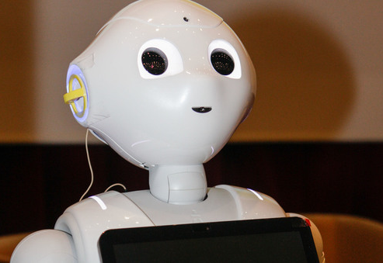
SPRINT RETROSPECTIVE
Notes:
REVIEW THE PROCESS AND TEAM WORKING. CAPTURE WHAT WENT WELL AND WHAT COULD INPROVE FROM THE PROCESS OR TEAM DYNAMICS.

Slide 10
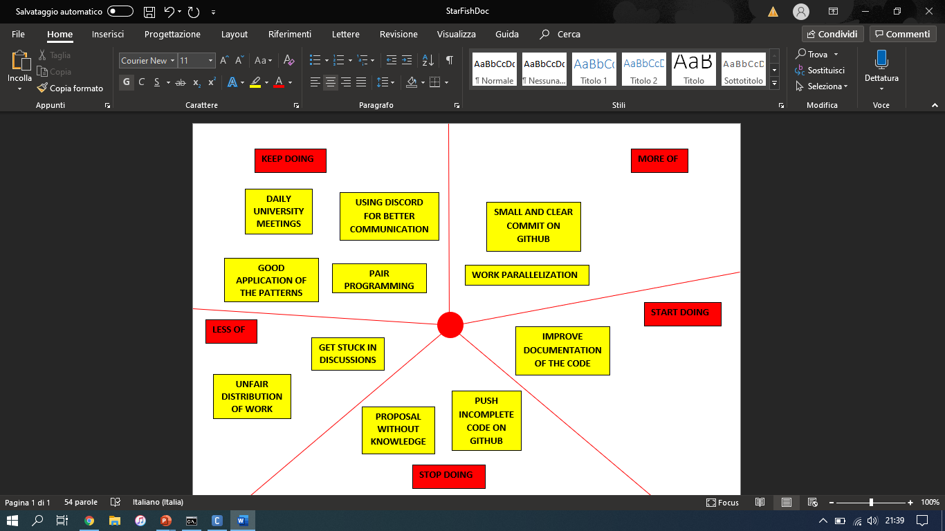
STARFISH DIAGRAM

Slide 11
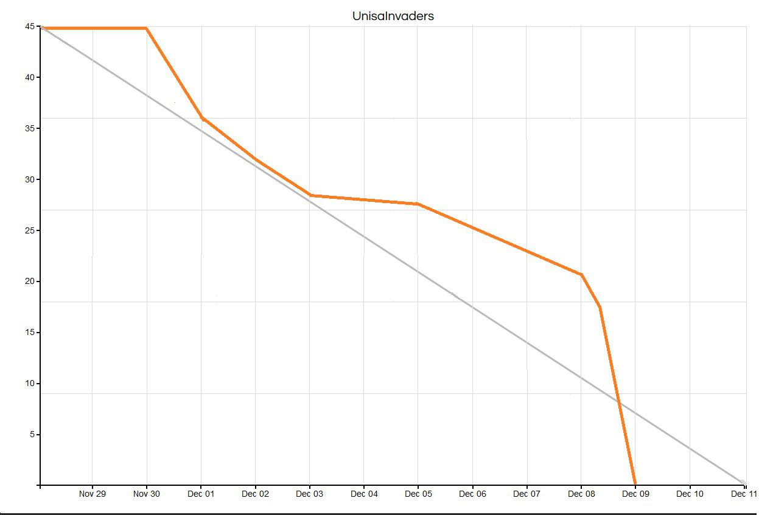
BURN-DOWN CHART
CURRENT SITUATION
IDEAL SITUATION

Slide 12
DEMO

Slide 13
FOR TODAY WE CAN STOP HERE!

